Slide 1



Slide 2
OBS Management
2023

Slide 3
OBS Management Process
Contents
Obsolescence Management
Component Engineering
Alternate Finding
Case Studies

Slide 4
Obsolescence Management Competency
Obsolescence Management
Embedded Firmware
Application SW
Mechanical Design
Prototyping
Product Qualification
Component Engineering
Electronics Design Engineering
ECAD- PCB Layouts
Sourcing
Engineering
Documentation
Component Engineering
Hardware development
Firmware development
HMI application development
Testing
Real time monitoring of the components obsolesce status
Automated obsolesce management system
Live component and PCB levels dash boards and reports
Alerts on component status
Dedicated team monitoring the component status
Develop a strategy for obsolescence management
Address current issue of EOL, LTB
Forecast and plan obsolescence in advance
Identifying components available with the required features.
Analysis of the components and identifying best match with respect to features and modifications needed for H/W and F/W.
Designing the hardware to test the components.
PCB designing.
PCB manufacturing and assembling.
Alliance partner for PCB manufacturing, EMI EMC testing
Analysing the existing firmware.
Identifying the changes needed.
Updating the firmware so that the new and earlier components can work with the same
Developing new interface modules required.
Developing the test cases
Designing the HMI screens to setup the tests, execute them and display results online.
Developing the modules to capturing the test results online and saving them.
Developing the interface modules to interact with different test instruments.
Implementing protocols needed to interact with different test instruments like Modbus and ASCCI.
Interfacing with third party drivers.
Running the tests through HMI
Monitor and capturing the test results.
ESD safe environment to handle dedicated parts
High temperature testing oven
Environmental chamber (-30ºC to +250ºC)
High temperature soldering and de-soldering setup
Developing test suite.
Hardware testing.
Analysing test results and preparing the test report.

Slide 5
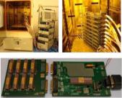
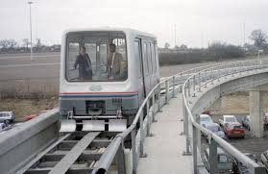

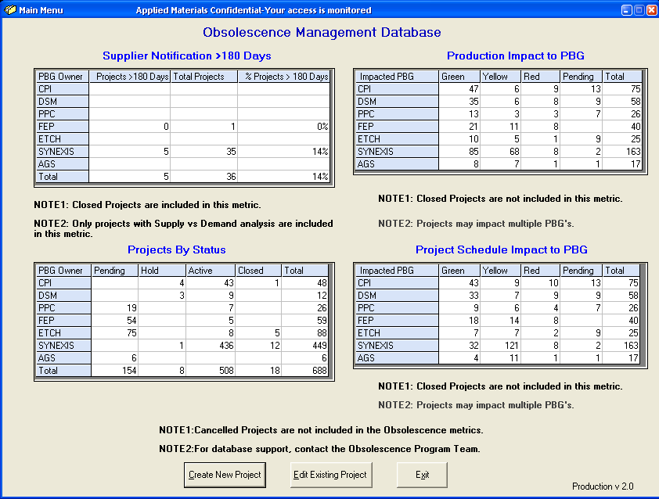

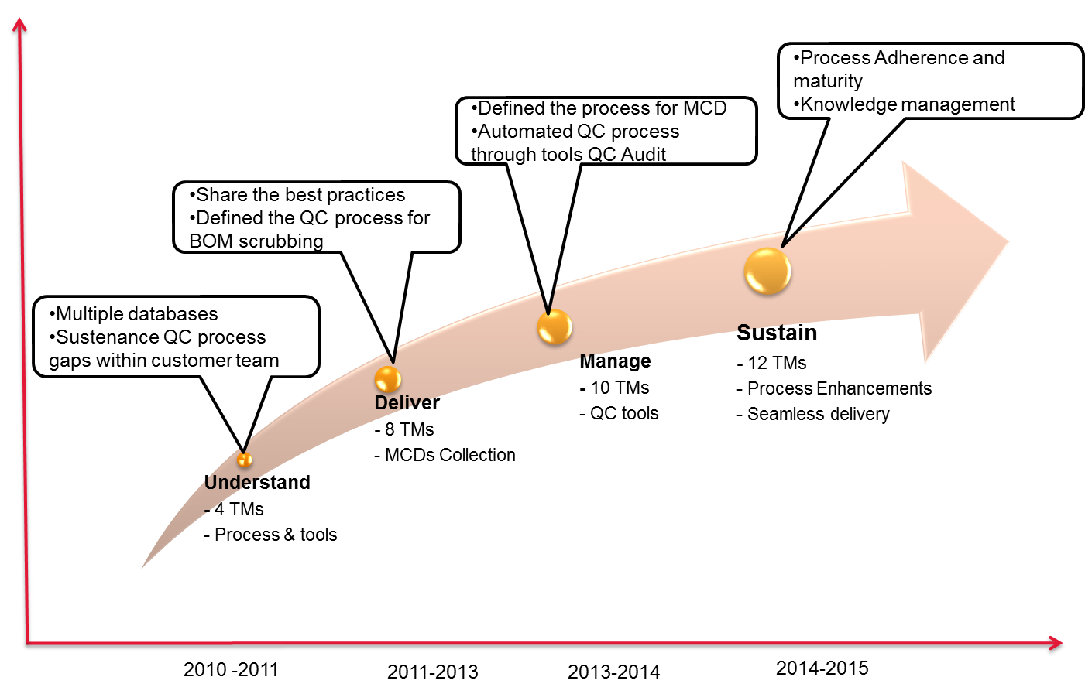
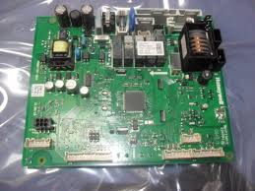
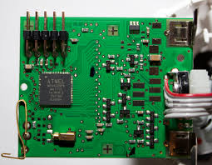



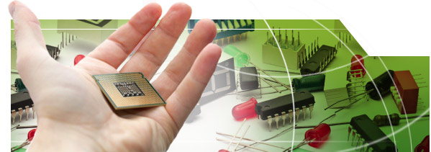
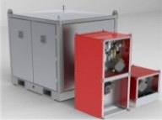
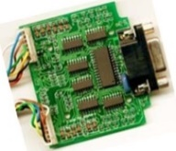


Breadth of our expertise across industries
Semicon equipment manufacturer
US based conglomerate – commercial and consumer product
Semicon equipment manufacturer
NA based Railway Transport Major
Leading Fire and safety solution provider
Global Oil Field Equipment Manufacturer
Developed and Maintaining Automated Database to handle component obsolescence
Monitoring the status of each obsolete part & tracking until implementation.
10000 components scrubbing and monitoring
ECR processed to implement 1100 replacements
Provided uniform solution for affected assemblies with quick turnaround for production issues
Agile Database monitors & track the status of each obsolete part until the implementation of the solution
Highly experienced Engineers integrated with product engineering team for design validation
Obsolescence watch, quality checks, Duplicate Extraction
Mature CE process to achieve high quality outputs in faster line
9+ years of engagement
10000+ components scrubbing and monitoring
Complete life cycle ownership – board redesign, FW upgrade, SW rewrite, prototyping, testing & validation as per compliance requirements
7+ years of engagement
Complete life cycle ownership – board redesign, FW upgrade, SW rewrite, prototyping, testing & validation as per compliance requirements
Value engineering and Standardization
Supplier sourcing support with cost negotiation for best cost
Peak Team Size – 35+
Peak Team Size – 10+
Peak Team Size – 20+
Peak Team Size – 12+
Peak Team Size – 30+
12
Notes:
AMAT – tool for automated tracking and reporting, 10000 components, long term engagement
GETS – onsite and offshore model, signaling, onsite for specific testing
UTC –
HAL – high temperature testing at offshore
Honeywell – value engineering, standardization, supplier and cost negotiation

Slide 6
Component engineering

Slide 7



Component Engineering
Segregation of the given list of components into multiple categories like Electrical , Mechanical, Electromechanical & Custom parts
Working with BOM manager tools and other distributors for alternates and Parts at risk
Preparing comparison sheets for the proposed alternates
Suggestions on the best possible alternates
Vendor Communication for data and certification related issues
Alternate finding for Custom Parts
Collecting PCN,PDN, RoHS and Reach Statements
Tools Used

Slide 8
Alternate Finding

Slide 9
Alternate Finding
Considerations while selection of Alternate
Application Circuit Complexity : Having Detailed understanding the Circuit application will result in better component selection.
Electrical parameters : This is the Core of requirement. Ex : Voltage , current, Power, Accuracy , Response Time, Speed, Resolution.. etc. Make sure to Make a list so that critical parameters won’t be missed.
Manufacturers : Consider a manufacturer Who has good product documentation like informative datasheets, Application notes, Reference design , Evaluation Board support & Technical/Design review Support.
Mechanical Parameters (Dimensions, Package, Weight. Etc): PCB size will be increased with large size components. Complex component Packages will result in increased assembly cost. Component weight also be the product weight deciding factor.

Slide 10
Alternate Finding
Considerations while selection of Alternate cntd.
Environmental parameters : Check properly the operating/storage temperature, humidity, pressure & vibration range. Which will cause the field surprises like field failures or bad performance.
Compliances : Component should have minimum compliances like ROHS & REACH.
Long term Availability/End Of Life: Make sure the component availability based on the product life cycle.
Lead Time : Component with long lead time will impact the product delivery schedule and stocking the component will affect the product overall cost.
Cost : Component cost should be as less as possible for better marketing strategy. But sometimes Component cost has less priority that product quality and size. So, the decision has been taken before considering the component cost.
Where to Buy : The selected component should be available from trusted distributors along with the manufacturer.

Slide 11
Alternate Finding
Execution Approach
Segregation of the list
Preparing the comparison
Verification with BOM Manager tool & Distributors
Require Additional data on alternate
Yes
Contact Vendors/ Manufacturers
Require Additional data on existing part
No
No
Yes
Contact Customer
Response received
Finalizing the comparison
Yes
No
No
Data received
Finding the alternates
Yes
Submit for final review with Customer

Slide 12
Alternate Finding
Conclusion and Recommendations
Drop-In Replacement
Requires Qualification
An alternate which doesn't require any changes in terms of Hardware, Software and Functionality.
If the alternate is from same Manufacturer as the existing this kind can be suggested as direct replacement.
If the drop-in replacement is from a different manufacturer leave the decision to the customer for Qualification
An alternate which has a few changes in the functional parameters , but if they are in acceptable range.
These must be recommended as alternates which requires qualification
Hardware / PCB Changes
An alternate which has different Pinout or PCB Footprint or Different package than existing part
These will need a lot of efforts and qualification either on existing or prototype boards

Slide 13
Alternate Finding
Conclusion and Recommendations
Firmware Changes
A part which needs changes in programming when replaced
Many of the Controllers or memories will need a change in the programming to achieve the functionality as the existing part.
These need to be recommended as the alternates which need Firmware changes

Slide 14
Case Studies

Slide 15
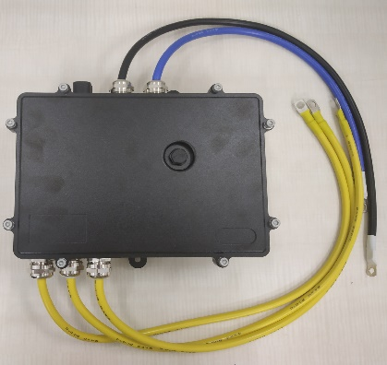
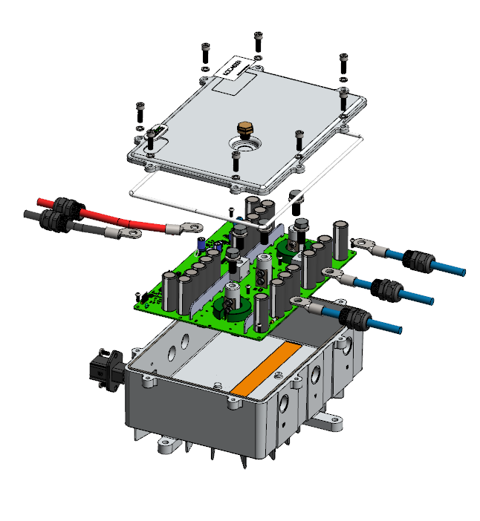
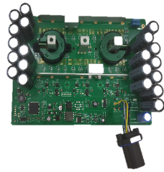
Cost Optimization of Active Rectifier: 1/2
Scope
To identify cost out ideas for active rectifier in below areas
Electronic Design review
Proposing low cost FFF alternate parts for the electronic components
To identify alternate supplier quotes for electronic manufacturing services and mechanical components from China and India
Inputs
Physical unit
Product Cost BOM, 2D drawings, 3D Models, assembly drawing and assembly instructions
Functional Block Diagram, schematics
Estimated annual usage
Manufacturing Location – China
Major Deliverables
Alternate electronic components with optimized specifications
Low cost alternate FFF (Form, Fit & Function) parts with specification and cost comparison sheets
Low cost vendor quotes from India and China for below items
Custom made parts like PCB & Cable harness
Mechanical components
Electronic Manufacturing Services
Business Benefits
Showcased 25% savings on overall product cost
Optimized design in 4 areas (Microcontroller, MOSFET, Angle sensor and cable)
Identified low cost FFF alternates for 8 electronic components
Provided low cost vendor quotes for 6 parts
Provided 9 new Vendor connects to customer from India and China

Slide 16





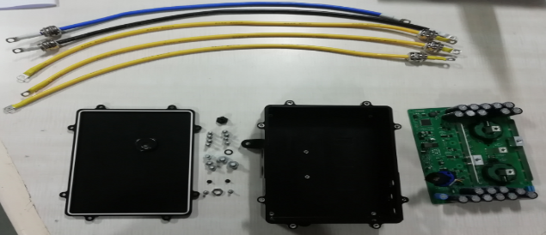
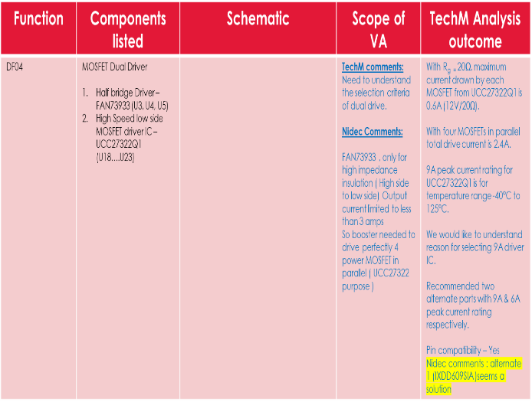
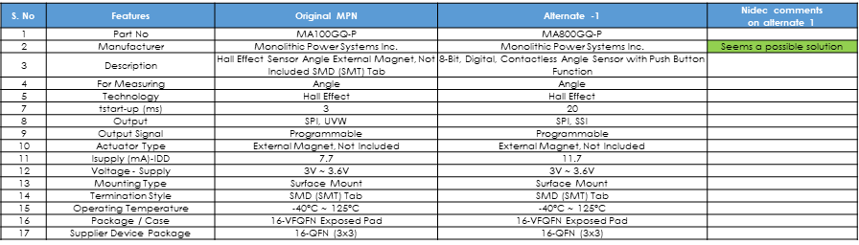
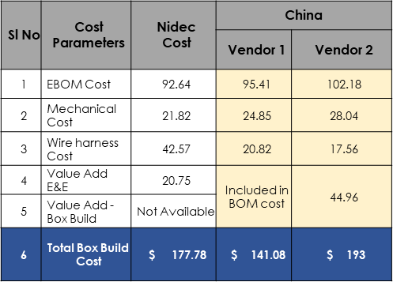
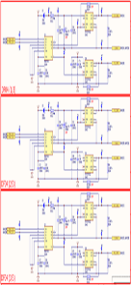
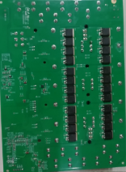
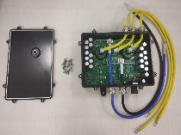
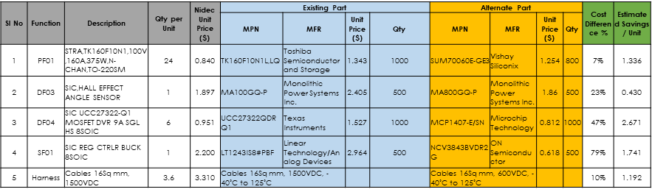
Project Execution Approach: 2/2
Identification of Low cost FFF alternates
Low Cost Alternate vendor Identification
Input Study
Design Review
Idea Generation
Product Study
Understanding the functionality
Teardown
Study the schematic
Identify areas for Cost optimization
Schematic Analysis
Identify high cost components in BOM
Brainstorming on idea generation
Check the feasibility for implementation
Shortlist the ideas
Datasheet study
Prepare Comparison Sheets w.r.t. existing parts specs
Float RFQ to supplier
Verify cost competitiveness
Identify vendors for Mech parts & EMS in China\India
Float RFQ
Quote analysis
Quote Finalization
Teardown
Schematic Analysis
Low cost FFF alternates Specifications Comparison
Vendor Quote Comparison

Slide 17
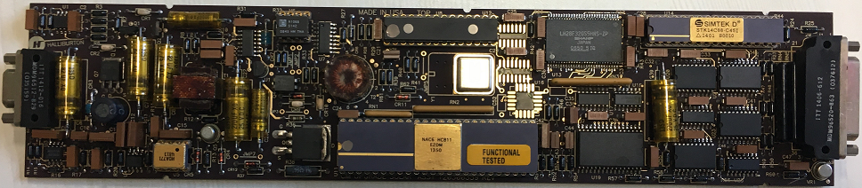

Success Stories
NVSRAM replacement and Firmware modifications
USB Controller selection and qualification
Analyze the functionality and specification requirement of the USB controller IC in current design.
Identify and study the IC’s with similar functionalities. Create detailed Pugh matrix for selection(based on performance, cost, availability).
Hardware interface design and porting the existing firmware for the identified IC’s.
Testing the new IC to check the desired performance and functionality.
Verifying the IC with new design for down hole high temperature conditions.
Find out replacement for the existing NVSRAM with minimal changes in both Hardware and Firmware
Analyse the schematics of the existing Hardware and firmware
List out firmware modifications required for the new replacement
Modify the firmware so that both the existing and the new alternate can work with one
Prepare the test plan for qualification with modified firmware @ 180 C
Log the real time test data for all 600 hrs. of high temperature testing (@180 C)
Prepare the test report and the new firmware release notes

Slide 18
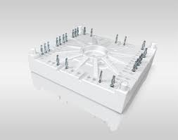
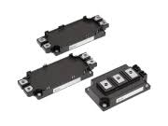
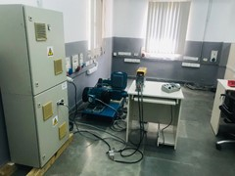
Obsolescence Management – Power Devices & others
Scope:
Complete Ownership of product obsolescence activities for components in VFDs:
Requirement analysis based on PCN / EoL notification from suppliers
Component usage in products, BoM affected by change
Assess impact on UL file
Search alternate components, generate technical comparison and propose commercial strategy
Procure samples, validate and generate test reports
Raise ECN and update design documents (BoM, schematics, layouts, etc)
CIB modules and IGBTs:
Characteristic comparison
Gate resistance assessment
Power Loss calculation and assess changes required in product
Procure samples and validate
Switching characteristics
Temperature rise test
Overload behavior
BoM, schematic and PCB layout update
Regenerative test set-up in PE lab

Slide 19
Thank you
Visit us at www.techmahindra.com

